Slide 1


Graduation Project 2025

Slide 2
Topics covered:
1] Projects by members from our team:
1.1] Website
1.2] Android app
1.3] Machine learning
1.4] Neural networks
1.5] Algorithms
1.6] PowerBI
2] The main idea of the graduation project

Slide 3

Projects by our team members You can find more on our repository: https://github.com/Graduate2025/projects

Slide 4
website

Slide 5
Distributed Database Inventory Website
distributed database inventory website built with Python. The project aims to create a scalable and fault-tolerant system, optimizing performance through data distribution and efficient query processing.
Components:
Frontend Interface:
HTML, CSS.
Backend Server:
Python (Flask)
Distributed Database:
Microsoft SQL server management
Deployment:
Cloud Deployment:
Azure.

Slide 6

Cairo
Alexandria
Cairo(Local)
Alexandria (Replication)
Alexandria(Local)
Port Said (Replication)
Port Said
Port Said(Local)
Cairo (Replication)

Slide 7
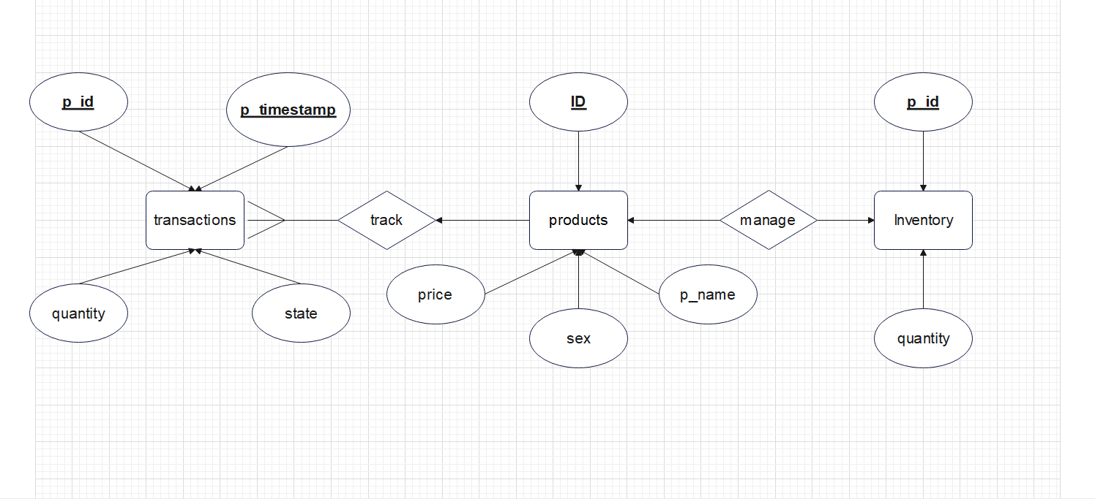
Local

Slide 8
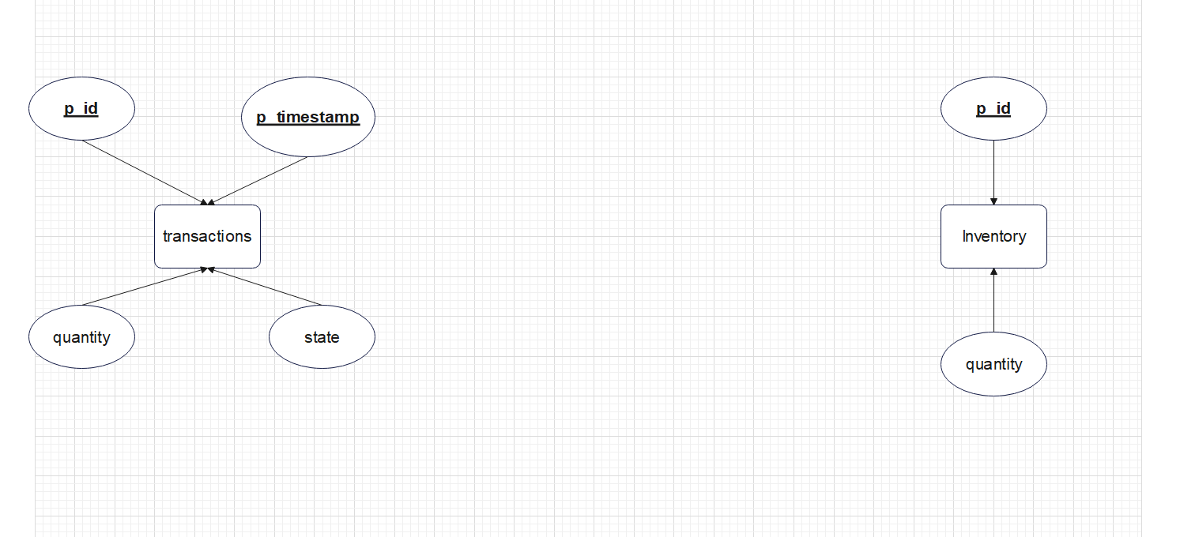
Replication

Slide 9
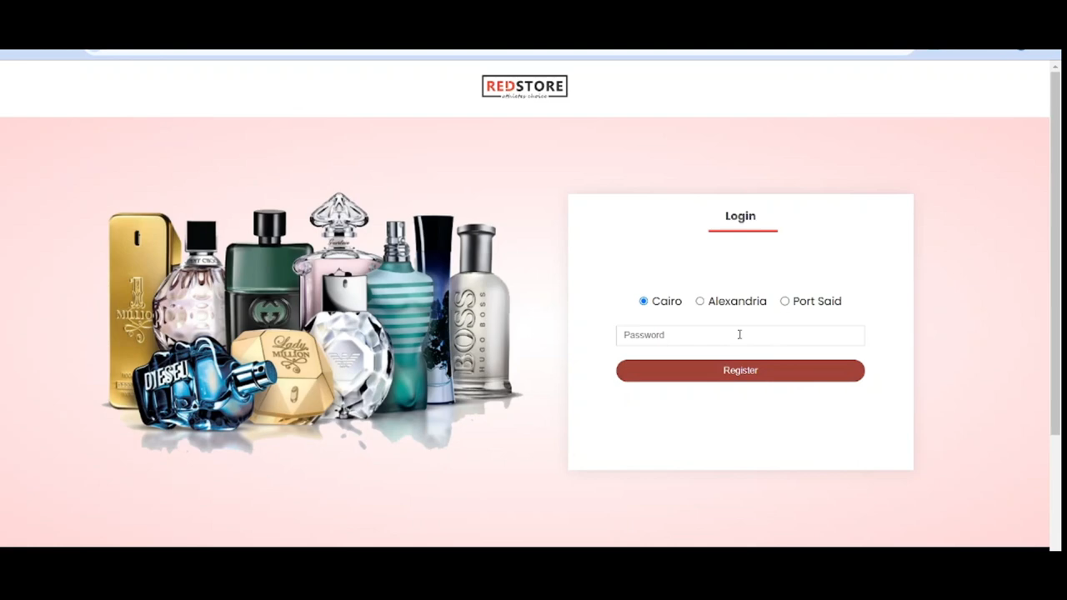

Slide 10
Mobile

Slide 11
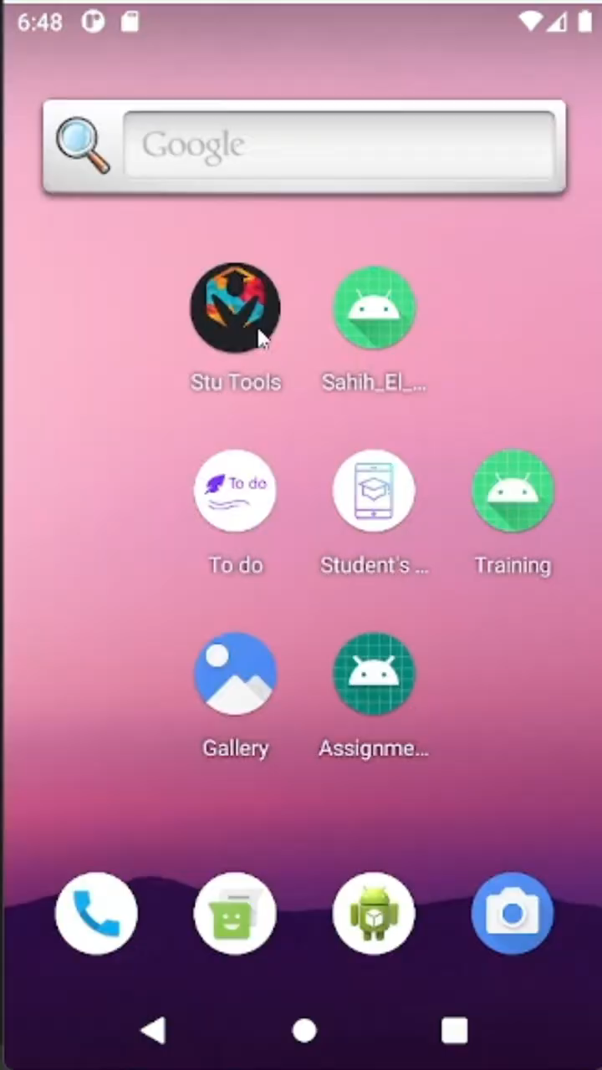
Student Assistant: An Android Mobile App
Description: A comprehensive mobile application designed to assist students in managing their daily academic tasks efficiently.
Features: Todo List, Lecture Schedule Table, GPA Calculator.
Platform: Android.

Slide 12
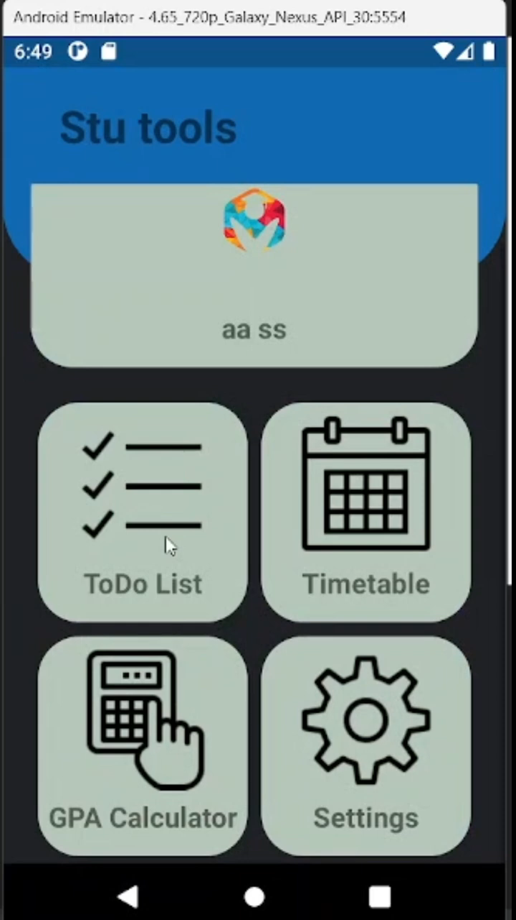
Todo List:
Functionality: Allows students to create and manage their to-do tasks.
Key Features: Add, delete, update tasks; mark tasks as completed.

Slide 13
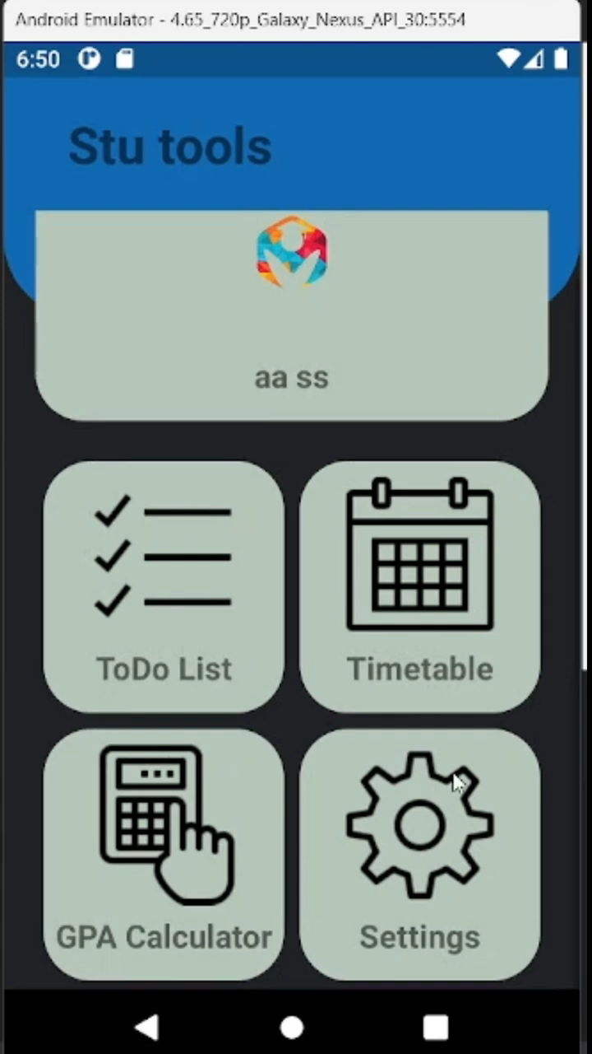
Lecture Schedule Table:
Functionality: Provides a structured view of the student's lecture schedule.
Key Features: Add lectures with details ; view schedule in table format;

Slide 14
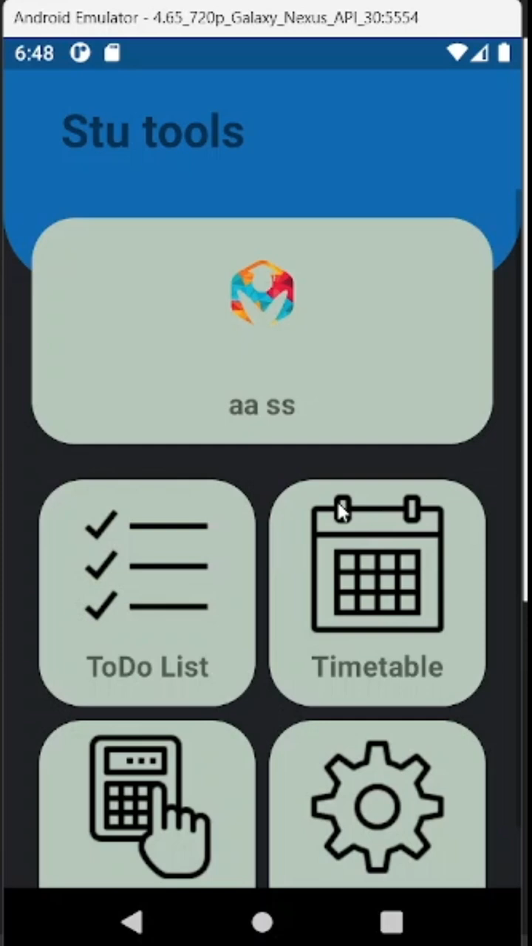
GPA Calculator:
Functionality: Helps students calculate their GPA based on grades obtained in different courses.
Key Features: Add courses with credits and grades; calculate GPA automatically.

Slide 15

User Authentication (Sign Up, Sign In):
Functionality: Allows users to create new accounts and sign in securely.
Key Features:
Sign Up: New users can register by providing necessary details like email, password, and additional information.
Sign In: Registered users can securely log in to their accounts using their credentials.
Forgot Password: Option to reset the password in case users forget it, ensuring account access.

Slide 16
Machine Learning

Slide 17
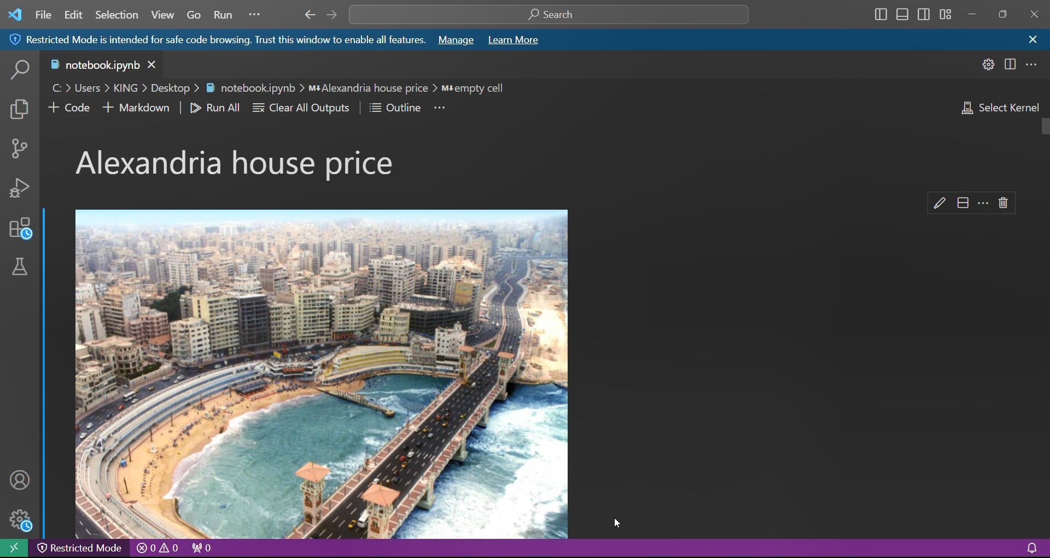
Housing in Alexandria
This project focuses on analyzing housing prices in Egypt using a dataset named "Egypt_Houses_Price.csv."
The dataset contains essential features such as the :
- property type - number of bedrooms - price
- bathroom area - furnished status - level
- compound - payment options

Slide 18
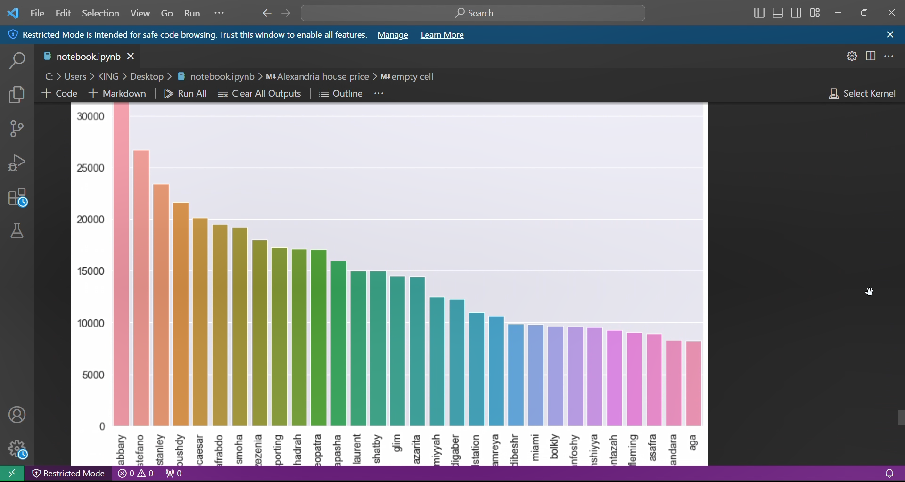
The dataset underwent extensive data preprocessing to handle missing values, inconsistencies, and standardize the data for analysis.
-Pandas
-NumPy
-regular expressions (re)
-FuzzyWuzzy

Slide 19
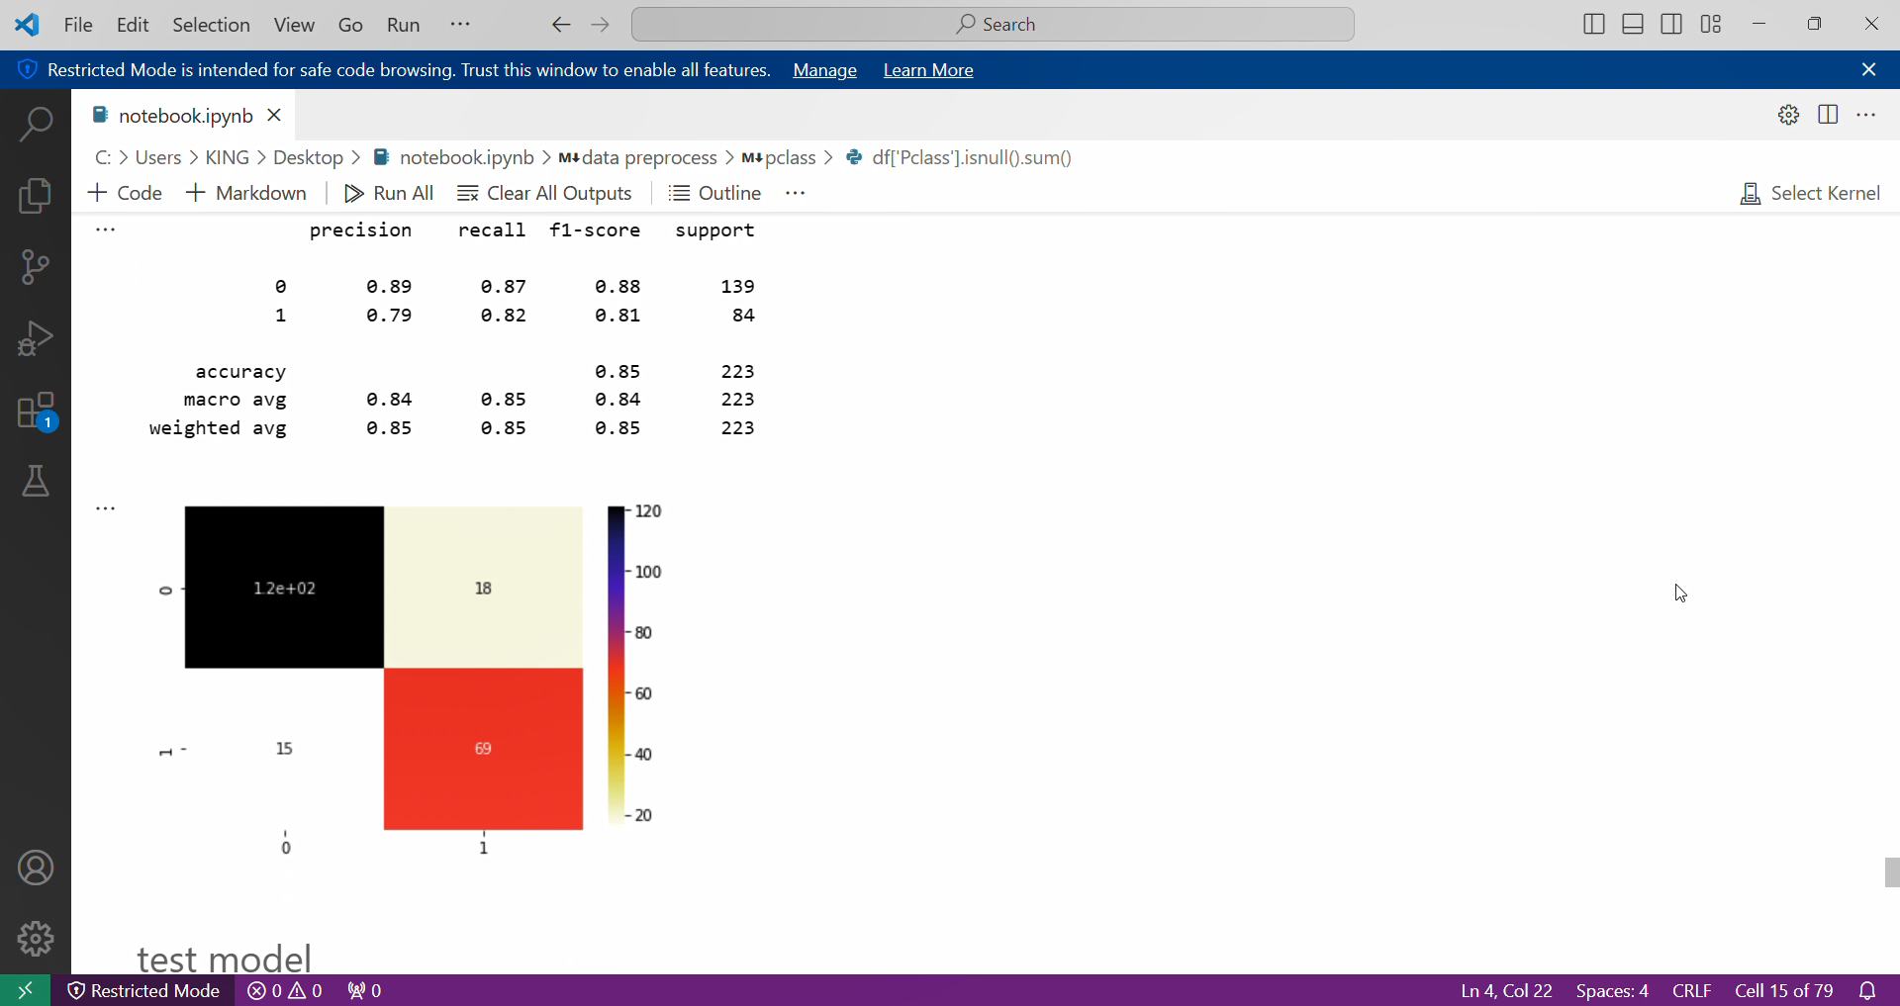
Kaggle Titanic ML Competition
The sinking of the Titanic is one of the most infamous shipwrecks in history. In this challenge, the goal is to build a predictive model that can determine which passengers were more likely to survive the disaster. The model will be trained using various features such as name, age, gender, socio-economic class, and more.

Slide 20
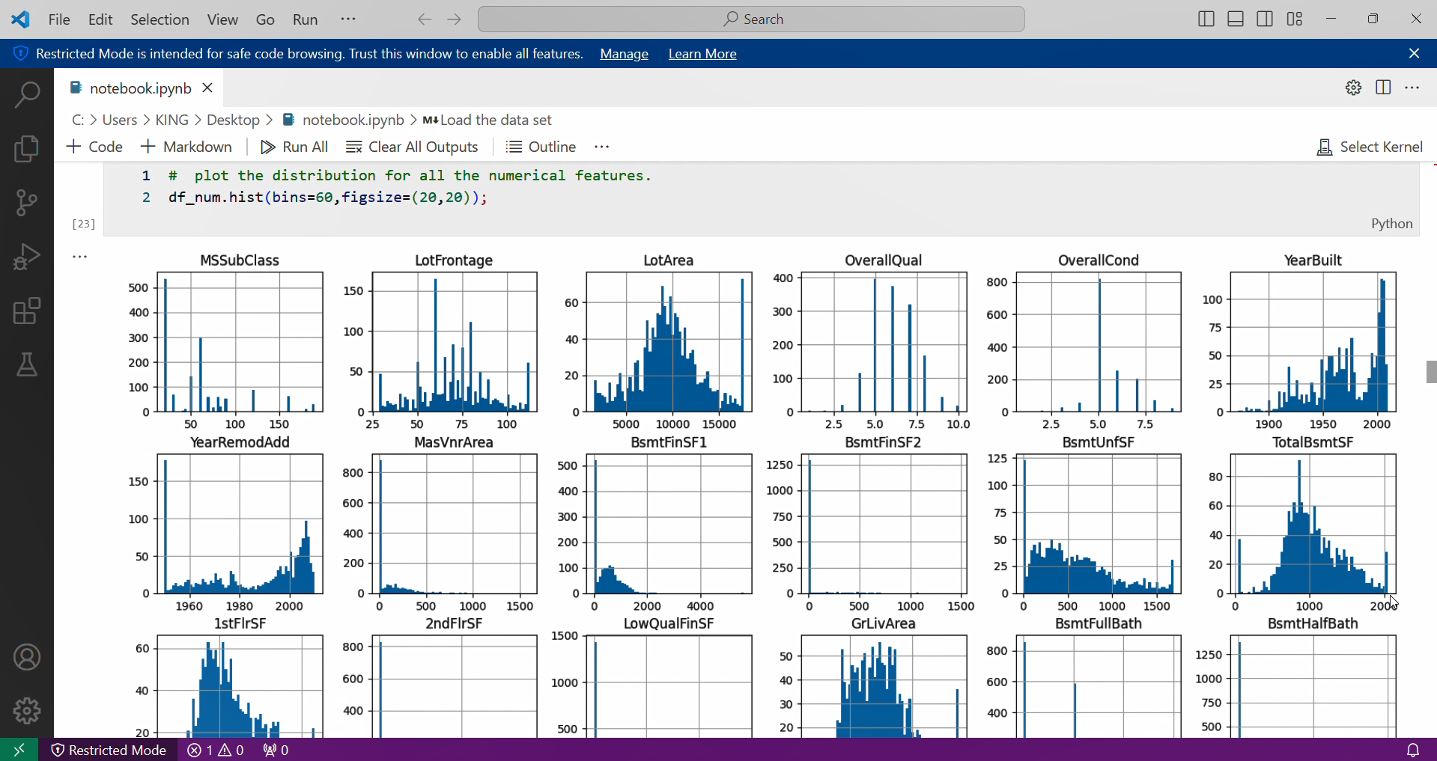
Kaggle Home Price Prediction
With 79 explanatory variables describing (almost) every aspect of residential homes in Ames, Iowa, this competition challenged participants to predict the final price of each home. It provided an incredible opportunity for data science students and practitioners to expand their skill set and apply creative feature engineering technique

Slide 21
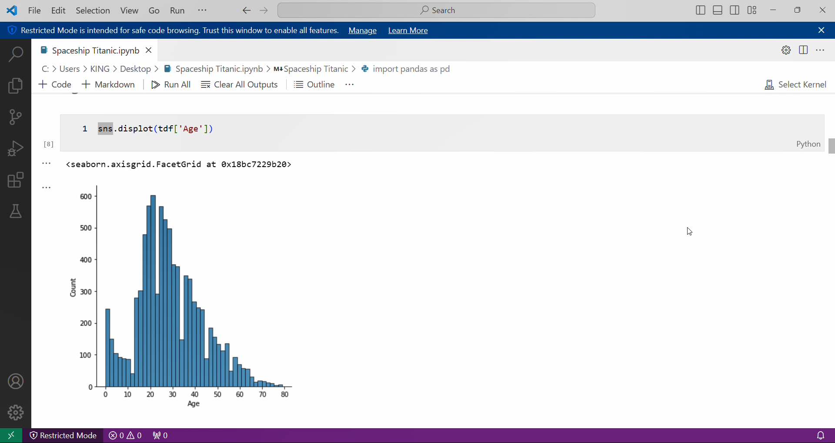
Spaceship Titanic
In the year 2912, the Spaceship Titanic encountered a spacetime anomaly while on its maiden voyage. As a result, almost half of the passengers were transported to an alternate dimension. Our mission is to utilize data science skills to investigate the anomaly and uncover the fate of the passengers.

Slide 22
Neural Network

Slide 23
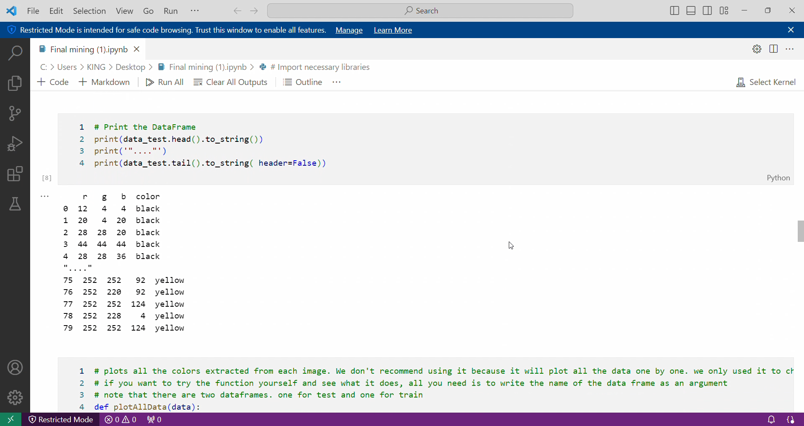
Color Detection
This project is about building an application that recognizes the color of an image by evaluating which color is most similar to the selected color value. The project uses Python programming language and a labeled dataset of available colors to train machine learning models that can detect colors easily. The project is useful for people who have difficulty remembering or naming colors, or for those who need to identify colors for various purposes.

Slide 24
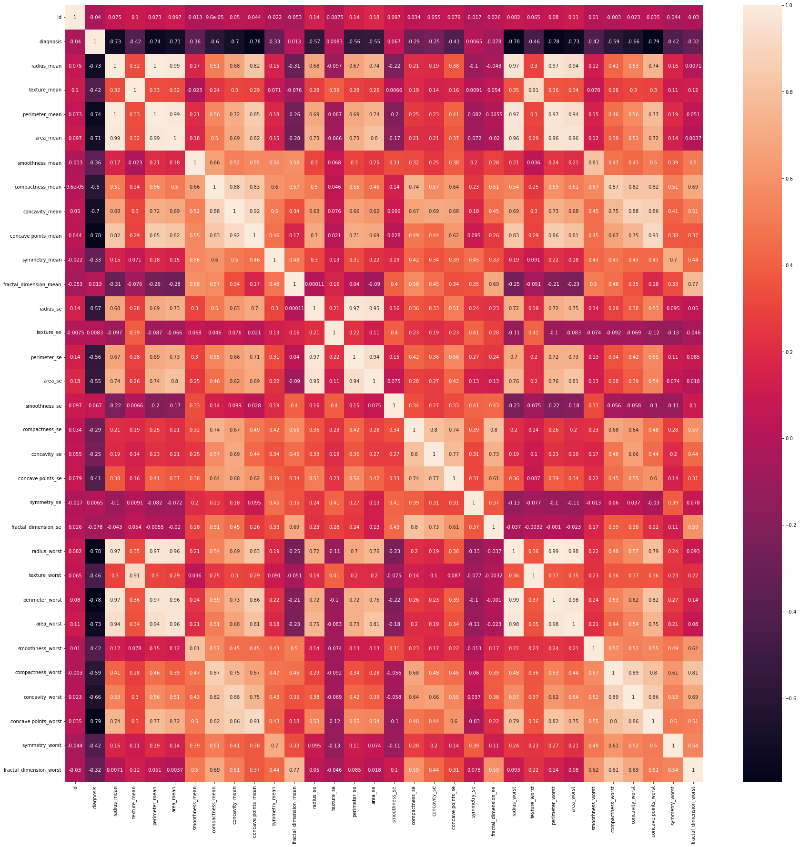
Cancer data set analysis and prediction
The Cancer.csv dataset contains data related to cancer diagnoses, providing information about various features and characteristics of diagnosed tumors. It is a valuable resource for tasks such as classification, aiming to predict whether a tumor is malignant or benign based on the provided features.

Slide 25
Algorithms

Slide 26
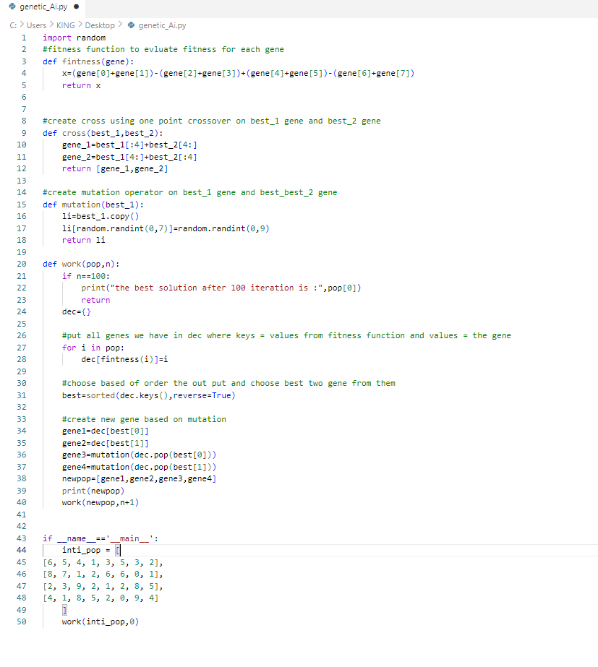
Ai Genetic Algorithms
the code is a simple implementation of a genetic algorithm for a generic optimization problem.

Slide 27
Linear equations
This Java program is designed to solve a system of linear equations using Gaussian elimination. The user is prompted to enter the number of equations and the maximum number of unknowns in each equation. The program then prompts the user to enter the coefficients of each equation, which are stored in a 2D array.
The program then performs Gaussian elimination to transform the system of equations into an upper triangular matrix form. Once the matrix is in this form, the program can determine whether the system has a unique solution, no solution, or infinitely many solutions.
If the system has no solution, the program prints a message indicating that the system is inconsistent. If the system has infinitely many solutions, the program prints the matrix in its reduced row echelon form and suggests that the user solve it by back substitution.
If the system has a unique solution, the program uses back substitution to solve for the values of the unknowns. The solution is stored in an array, which is then printed to the console.

Slide 28
Power Bi

Slide 29
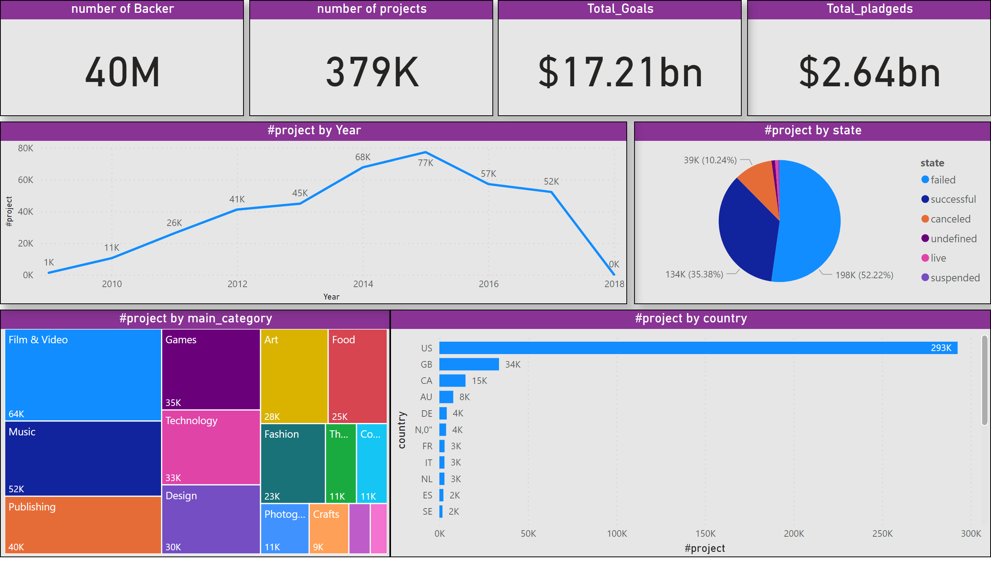
Page 1
- By analyzing this dataset, we can gain insights into the characteristics of successful and unsuccessful Kickstarter projects, such as funding targets, project categories, and funding sources. This information can be used to inform investment decisions and guide future crowdfunding campaigns.Overall, this dataset provides a comprehensive look at the Kickstarter ecosystem and can serve as a valuable resource for anyone interested in understanding the dynamics of crowdfunding and the factors that contribute to project success or failure.
Go To Dashboard: https://app.powerbi.com/MobileRedirect.html?action=OpenReport&groupObjectId=c717b43a-ca1f-4e56-aed2-933458109a51&Context=share-report&reportObjectId=66b078ec-5975-4fc9-919a-6a09e2710dfb&bookmarkGuid=9855c2ab-de6c-4fcb-9f36-891d29a9d3fd&ctid=eaf624c8-a0c4-4195-87d2-443e5d7516cd&reportPage=ReportSection&pbi_source=mobile_ios
Notes:
number of Backer
No alt text provided
Total_pladgeds
No alt text provided
number of projects
No alt text provided
Total_Goals
No alt text provided
pieChart
No alt text provided
treemap
No alt text provided
lineChart
No alt text provided
barChart
No alt text provided

Slide 30
R

Slide 31
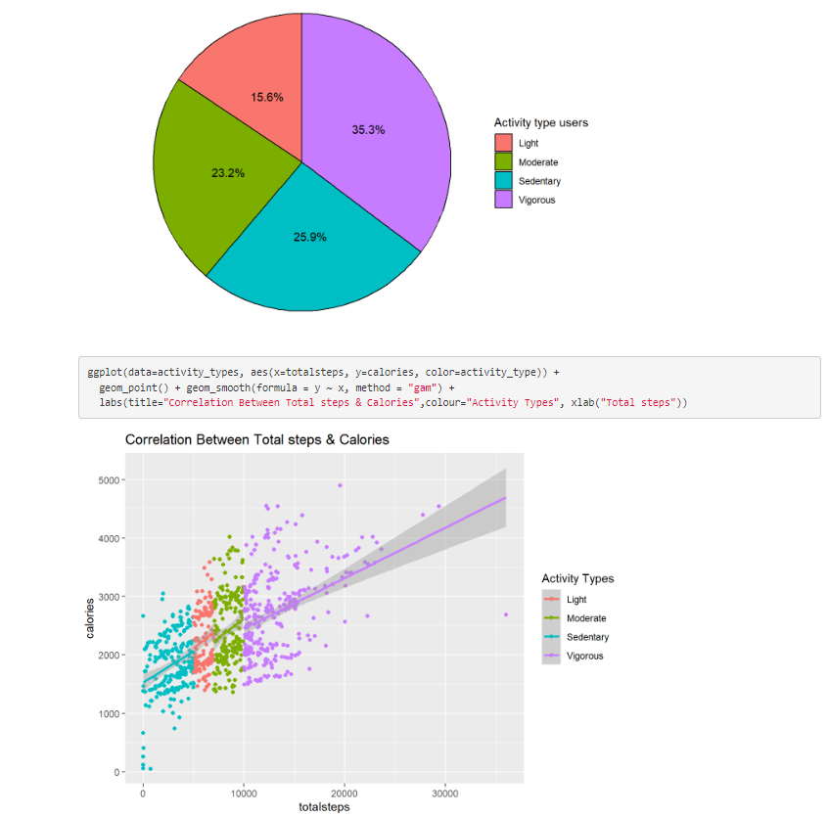
You have been asked to focus on one of Bellabeat’s products and analyze smart device data to gain insight into how consumers are using their smart devices. The insights you discover will then help guide marketing strategy for the company. You will present your analysis to the Bellabeat executive team along with your high-level recommendations for Bellabeat’s marketing strategy.

Slide 32

Graduation Project Idea

Slide 33
Page 1
In recent years, agriculture in Egypt has started to encounter several issues :
The emergence of water scarcity poses a significant challenge to agricultural activities in Egypt.
The limited availability of agricultural land exacerbates the constraints faced by the sector.
Decreased participation in agricultural labor among peasants contributes to workforce shortages.
Fluctuations in weather patterns disrupt farming practices and yield outcomes.
Rising transportation costs impose additional financial burdens on agricultural operations.
Inadequate investment in scientific research hampers advancements in agricultural techniques and technologies.
Notes:
number of Backer
No alt text provided
Total_pladgeds
No alt text provided
number of projects
No alt text provided
Total_Goals
No alt text provided
pieChart
No alt text provided
treemap
No alt text provided
lineChart
No alt text provided
barChart
No alt text provided

Slide 34
How we will solve this ?

Slide 35
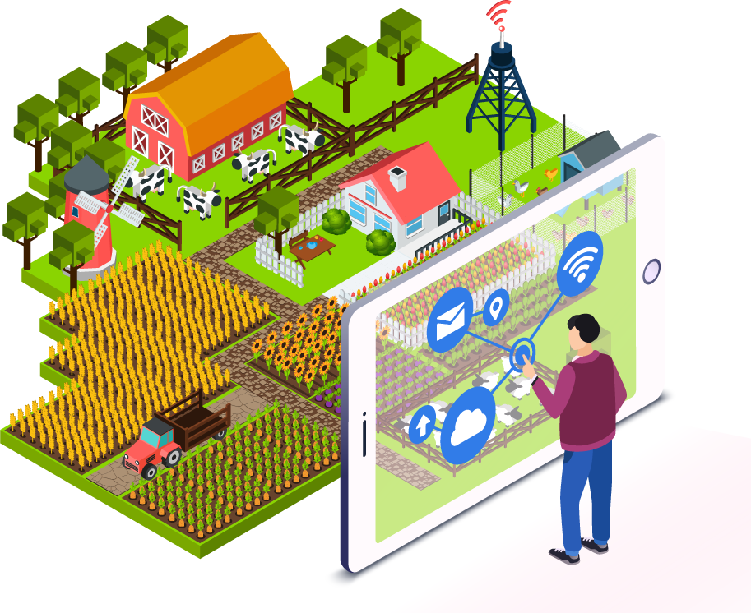
Internet of things
Internet of Things (IoT) plays a crucial role in smart agriculture. Smart farming is an emerging concept, because IoT sensors capable of providing information about their agriculture fields. The project aims making use of evolving technology. IoT and smart agriculture using automation. Monitoring environmental factors is the major factor to improve the yield of the efficient crops. The feature of this project includes monitoring temperature, humidity and moisture in agricultural field through sensors.

Slide 36
IoT (Internet of Things) smart agriculture solutions offer a range of benefits :
Precision Farming
Remote Monitoring
Data-Driven Decision Making
Resource Efficiency
Predictive Analytics

Slide 37
Precision Farming
IoT sensors deployed in fields can collect data on soil moisture levels, temperature, and humidity. This data can be analyzed in real-time to optimize irrigation schedules, fertilizer application, and crop health management, leading to increased yields and reduced resource wastage.

Slide 38
2. Remote Monitoring
Farmers can remotely monitor their crops from anywhere using IoT-enabled devices such as smartphones. This allows for timely intervention in case of pest infestations, diseases, or adverse weather conditions, helping to prevent losses.

Slide 39
3.Data-Driven Decision Making
By collecting and analyzing vast amounts of data, IoT smart agriculture solutions enable farmers to make informed decisions. This includes determining the best planting times, selecting suitable crop varieties, and identifying areas for improvement in farming practices.

Slide 40
4.Resource Efficiency
IoT sensors can optimize resource usage by providing insights into water and energy consumption. For example, automated irrigation systems can adjust water flow based on real-time soil moisture data, minimizing water wastage. Similarly, smart energy management systems can optimize energy usage in farm operations, reducing costs and environmental impact

Slide 41
5.Predictive Analytics
IoT data can be used to develop predictive models for various agricultural factors, such as weather patterns. This enables farmers to anticipate challenges and opportunities.

Slide 42
How we will apply this ?

Slide 43
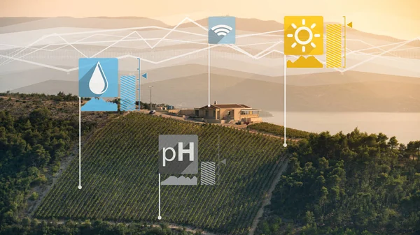
IoT Systems

Slide 44
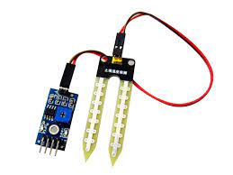
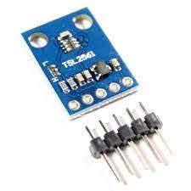
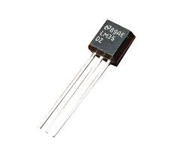
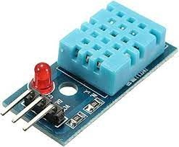
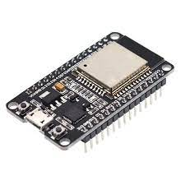
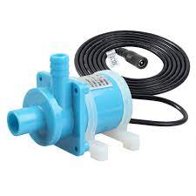
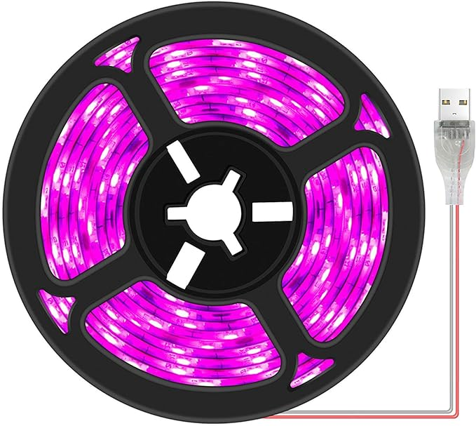
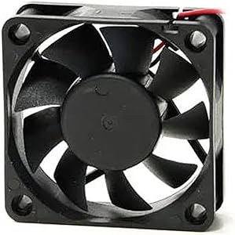
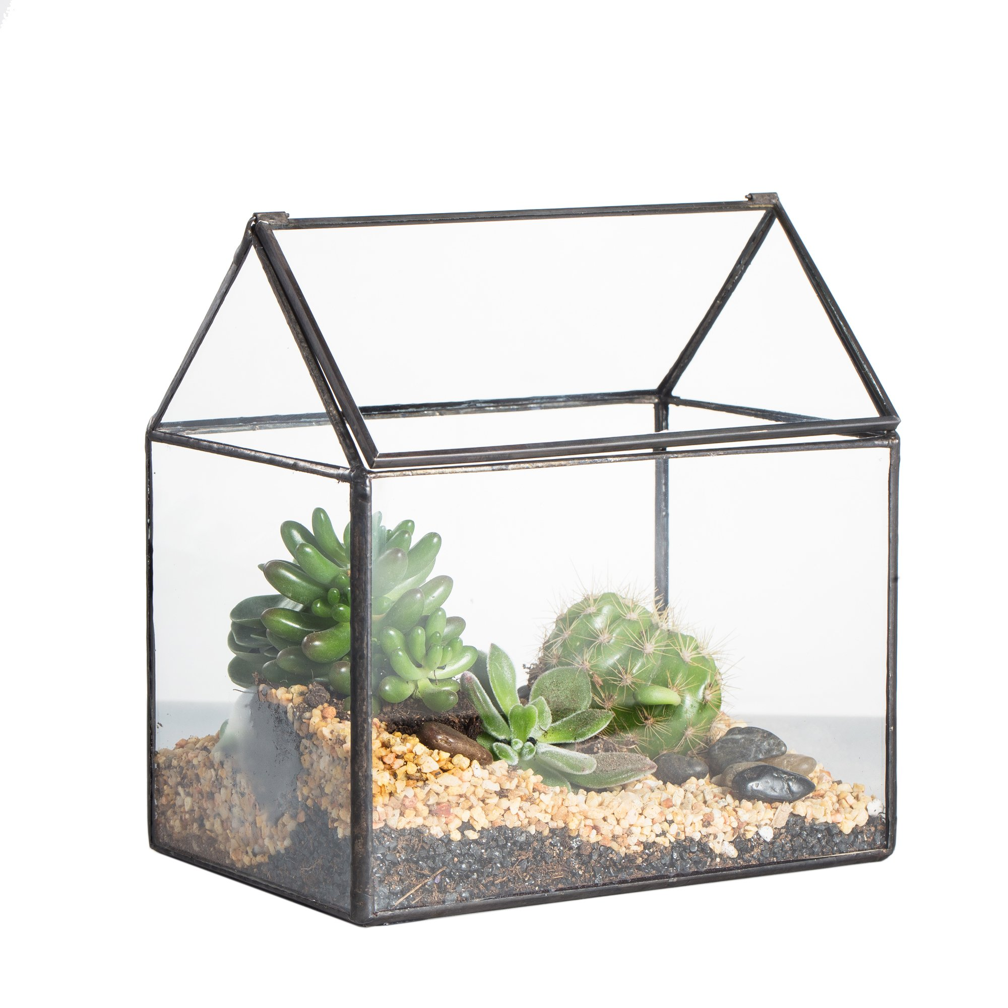
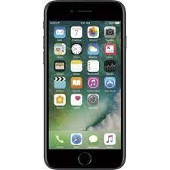
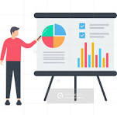

Soil Moisture Sensor
Light Intensity Sensor
Temperature Sensor
Humidity Sensor
ESP32
pump
Fan
Led
Green house
mobile
cloud
analysis

Slide 45
order
Ai model
notification
order
Data
report
order
Data
Update model
Data

Slide 46
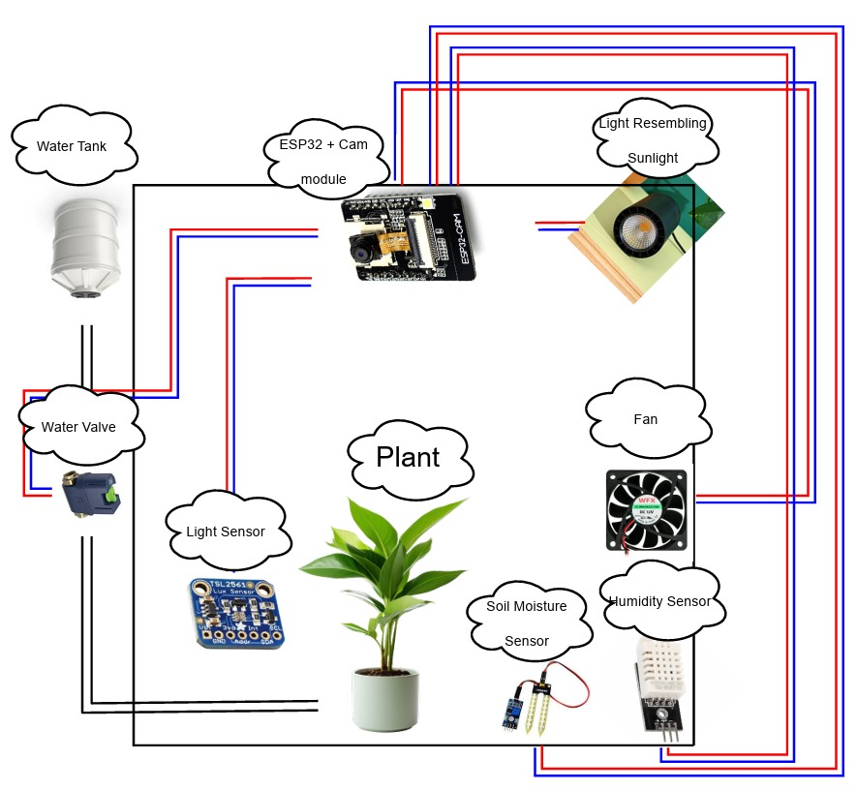

Slide 47

sensor
Light Intensity Sensor: sensor capable of measuring light intensity accurately. A common choice is the TSL2561 sensor or similar.
Temperature Sensor: For temperature monitoring, options include the DHT11, DHT22, DS18B20, or similar sensors.
Humidity Sensor: Sensors like the DHT11, DHT22, or BME280 can measure both temperature and humidity.
Soil Moisture Sensor: There are various soil moisture sensors available, such as the Capacitive Soil Moisture Sensor or the Resistive Soil Moisture Sensor.

Slide 48
Light Intensity Sensor:
Ensures plants get the right amount of sunlight for growth.
Helps adjust indoor lighting for optimal conditions.
Prevents plant diseases caused by insufficient light.
Temperature Sensor:
Prevents plants from overheating or freezing.
Helps in timing planting and harvesting for better yields.
Protects crops from frost damage.
Humidity Sensor:
Prevents moisture-related diseases in plants.
Maintains ideal humidity levels for healthy growth.
Guides efficient watering to avoid under or overwatering.
Soil Moisture Sensor:
Saves water by optimizing irrigation.
Boosts crop yields by ensuring proper soil moisture.
Facilitates better nutrient absorption for plants.

Slide 49
Another devices
Microcontroller or Single Board Computer (SBC): This serves as the brain of our system, controlling the sensors, collecting data, and managing communication. Popular choices include Arduino, Raspberry Pi, ESP32, or similar platforms.
Power Supply: Depending on our deployment location, we may need a power source. This could be mains power, batteries, solar panels, or a combination of these.
Connectivity Module: For transmitting data from the field to the central system, we'll need a communication module. Options include Wi-Fi, GSM/3G/4G/5G, LoRa, or NB-IoT, depending on the availability of network coverage in our area.

Slide 50
Enclosure: Depending on our deployment environment, we may need an enclosure to protect our electronics from dust, moisture, and other environmental factors.
Wiring and Connectors: we will have the necessary wires, cables, and connectors to connect our sensors to the microcontroller or SBC.
Data Storage and Processing System: we 'll also need a system for storing and processing the data collected from the sensors. This will be a cloud-based platform, or a combination of a local server and cloud.

Slide 51
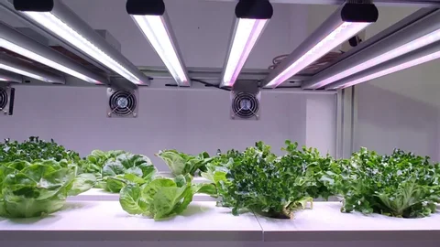
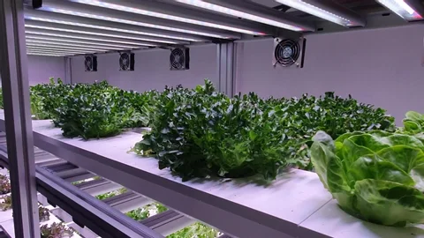
After collecting data from the sensors, we can use it to control the fan and LED in your smart agriculture system.
The microcontroller or SBC in our system can analyze the data from the temperature and humidity sensors and send commands to a relay or transistor to turn the fan on or off accordingly.
the microcontroller or SBC can process data from the light intensity sensor and control the LED using PWM (Pulse Width Modulation) to adjust its brightness or color based on the detected conditions.

Slide 52
Fan Control:
Temperature Data: If the temperature sensor detects that the temperature is rising above a certain threshold, indicating potential heat stress for the plants, the system can activate the fan to cool down the environment.
Humidity Data: High humidity levels can also contribute to heat stress. If the humidity sensor detects high humidity along with high temperature, it can trigger the fan to improve air circulation and reduce humidity levels.
LED Control:
Light Intensity Data: The light intensity sensor provides data on the amount of light available to the plants. Based on this data, the system can adjust the brightness of the LED to supplement natural light in indoor environments or provide additional lighting during low light conditions.

Slide 53
Smart Water Pump Control
Utilize sensor data, particularly from the soil moisture sensor, to determine when irrigation is needed.
Set a predefined threshold for soil moisture levels. When the moisture level falls below this threshold, it indicates dry conditions, triggering the activation of the water pump.
Provide users with the ability to remotely control the water pump system, allowing for immediate adjustments to irrigation schedules in response to changing conditions.
Reduces water bills and energy costs associated with irrigation.

Slide 54
How can data goes from sensors to cloud
The process of sending data from sensors to the cloud in a smart agriculture system involves the following steps:
1-Microcontroller can read sensors data directly and transmit it to a gateway device or directly to the cloud using protocols like MQTT or HTTP.
They may require additional hardware components, such as Wi-Fi or Ethernet modules, to enable internet connectivity.
2- The data is received by a cloud server . The cloud server stores the data in a database or data storage system.
3- Once the data is stored in the cloud, authorized users can access it using mobile application

Slide 55
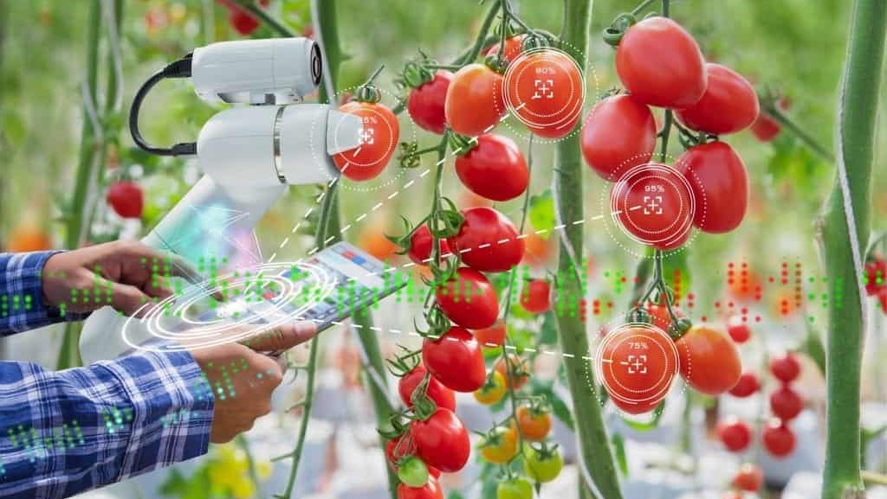
Ai and machine learning

Slide 56
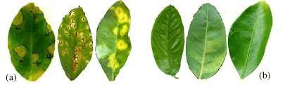
Plant diseases
One of the most life-threatning dangers to the plants are pathogens or diseases. They’re simply creatures that grows on the plant and causing plants organs like leaves, stem, roots to be sick which affects the funcionality they perform. Since it takes time to develop in the plant, we can still be able to detect it early. This requires constant watching over the plant and this is simply not something humans can do. This where AI kicks in. Let’s talk about leaves for example
Notice the difference between sick (A) and healty (B) leaves? We can easily tell by a picture of them. What if instead of observing leaves with the human eye, we trained a model that identifies sick from healthy leaves. Or you can take it further and identify what is the disease exactly and offer solutions or solve the problem itself.

Slide 57
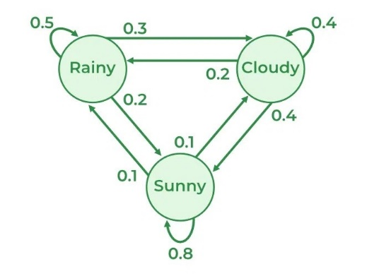
Better safe than sorry
In addition to detecting sick plants we should use AI to detect the possibility of getting infected in the first place. We first should know the nature of pathogens before we can fight them. Pathogens attack a specific host which is the plant in our case. For example Pythium is a pathogen that attacks tomatoes root. Pythium is hard to treat once infects the plant so farmers try to prevent its infection before it happens. “Before it happens” sounds like we could use AI to predict the future. We’ve data generated from watching the plants. AI can use this data in addition to information about the pathogens that attack the plant it’s trained to watch and predict if conditions like (humidity, moisture, teamperature, and soil condition) are going towards favourable conditions for a pathogen. That predictive model can later notify the famrers and also give insights about how to stop it. For example markov chains can be used. Based on the temperature now, I can predect the temperature at a point of time in the future. if the probability of being at a favourable temperature for a specific pathogen. We can consider this a threat
AI and Power optimization
We can use the same concept to optimizer our resources not just power but also water. Using historical patterns and the data we have we can predict:
- Rainfall times → help us utilize water resources
- Temperature → if it may get change to dangerous levels, try to start the fan early to keep the heat out or open the lamp to keep the cold out
Example of a markov chain that predicts the weather state.

Slide 58
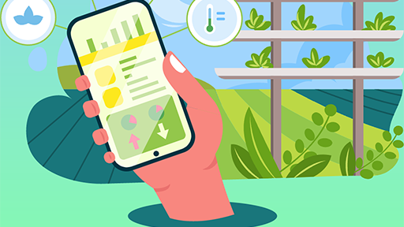
Mobile application

Slide 59
Why mobile app?
The app aims to empower usesr to monitor and manage their agricultural operations remotely, enhancing efficiency, sustainability, and decision-making.

Slide 60
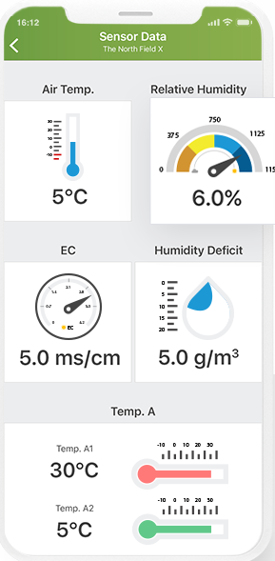
Real-Time Monitoring and Alerts
Farmers can remotely monitor crops, and sensors in real-time via mobile apps.
Instant notifications and alerts keep farmers informed about pest outbreaks, irrigation issues, Power outages or adverse weather, enabling prompt action.

Slide 61
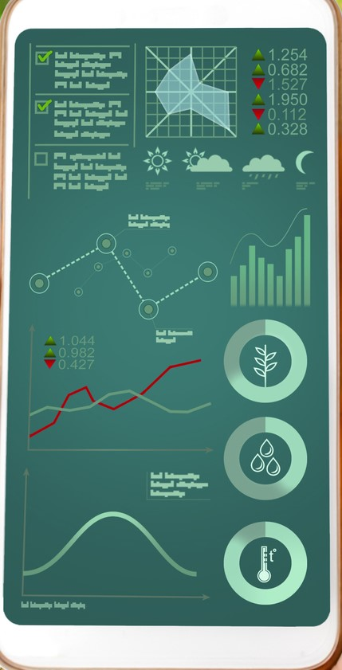
Data Visualization and Analysis
Mobile apps offer intuitive interfaces for farmers to visualize and analyze data collected from IoT sensors.
Graphs, charts, and maps aid in interpreting soil moisture, temperature, and other vital information.

Slide 62
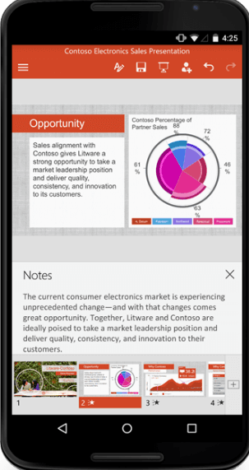
Monthly Data Analysis Reports for Informed Decision-Making
Generate monthly reports through data analysis, consolidating key insights and trends observed in the farm's performance.
Highlight significant changes or anomalies detected in the data over the course of the month, enabling proactive interventions.

Slide 63
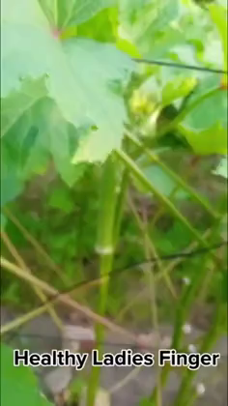
Future plans
Visual Monitoring with Camera
Utilize image recognition and analysis algorithms to assess plant health, growth stages, and detect any signs of diseases or pests.
Empower farmers to visually monitor their crops remotely, facilitating timely interventions and proactive management strategies.
Integration with IoT Devices
Mobile apps seamlessly integrate with IoT devices and sensors, streamlining data collection, control, and automation processes.
Remote adjustment of settings and real-time data insights empower farmers to make informed decisions from anywhere.

Slide 64
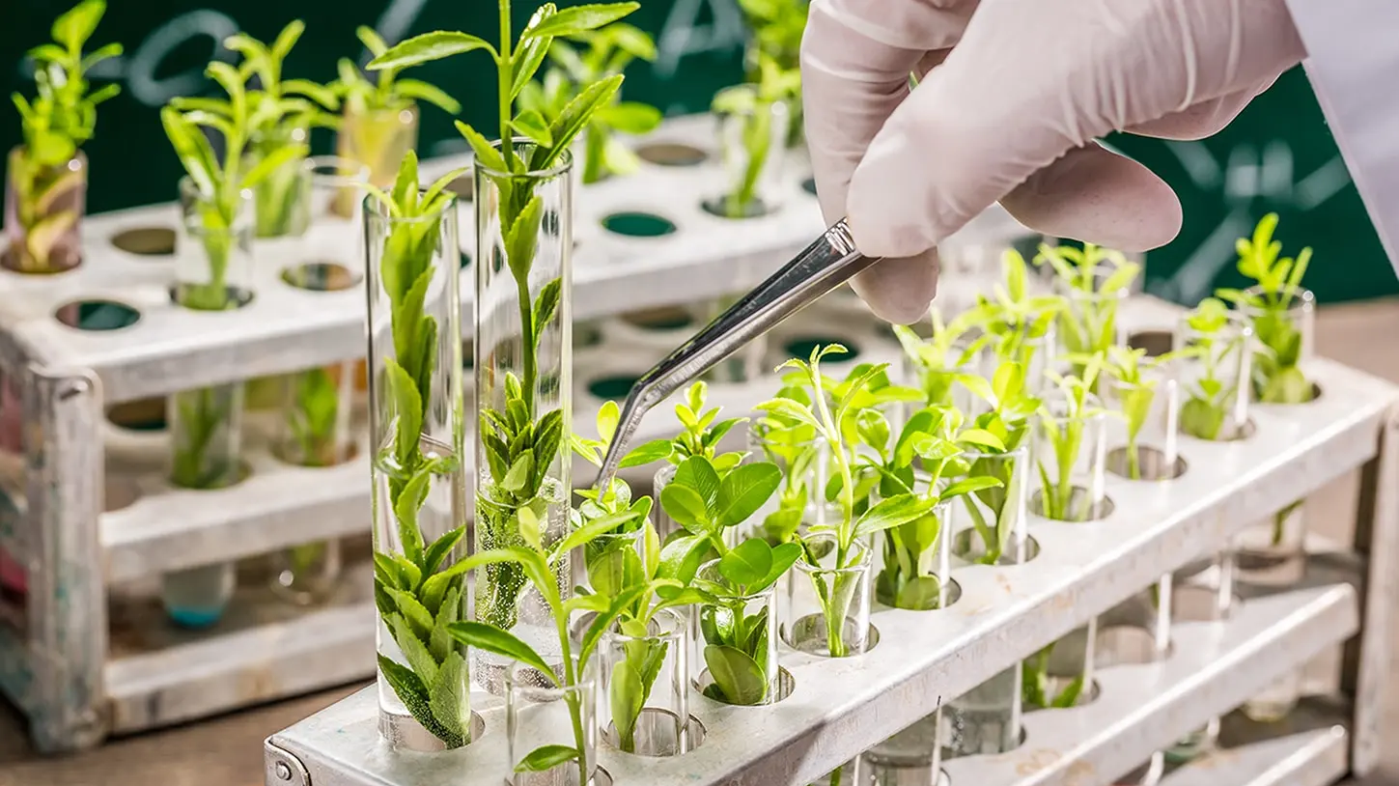
Analytics

Slide 65
Analytics
Predictive analytics: Farmers can use data analytics to forecast crop yields, weather patterns, and pest infestations. By analyzing historical data and real-time sensor data, farmers can make more accurate predictions and take pre-emptive actions to prevent crop loss.
Precision farming: Precision farming involves using data analytics to optimize crop production by tailoring farming practices to specific areas of the farm. By analyzing soil and moisture data, farmers can adjust irrigation, fertilizer application, and seed planting to maximize crop yields and minimize waste.
Real-time estimates
Real-time estimates refer to estimates or predictions that are updated and provided In real-time, meaning they are available instantly or with very little delay.
Real-time estimates in agriculture can refer to the use of various technologies and techniques to gather and analyze data in real-time to improve farming efficiency and productivity. Some examples of real-time estimates in agriculture include:
Weather and climate monitoring: Real-time weather and climate data can be used to help farmers make decisions about planting, irrigation, and harvesting. This can be done through various sensors and weather stations that collect data and provide real-time updates to farmers.
Soil monitoring: Real-time soil monitoring can help farmers understand soil health and nutrient levels, allowing them to make informed decisions about fertilization and other farming practices.

Slide 66
Time series analysis
Time series analysis can help us in agriculture in several things such as :
Weather Forecasting: we can forecast the weather by temperature sensor and this can help us in Energy saving
uncover hidden correlations: by time series analysis we can find correlations between features and each other like temperature and moisture etc and then we can find The best environment for plants
Irrigation Management: by Time series analysis of data such as soil moisture levels can help us optimize their irrigation schedules this schedules can help us when we send to the user best irrigation schedule and can help us if moisture sensor breakdown then we can use this schedules
monthly report : we can benefit from time series analysis in making monthly report to the user on things like The amount of water used in this month , the range of temperature , etc.
visualize the data : we can do some visualization in data which came from time series analysis and the user may benefit from those plots
Anomaly Detection : Time series analysis helps identify abnormal , unexpected patterns or High power consumption
And time series analysis may help us in other things ..

Slide 67

Estimated Cost for the Project

Slide 68
1-Arduino:
We will use Arduino MEGA 2560 with a WI-FI connector.
→1000-2000 L.E
2-Light Sensor:
TSL2561 or BH1750FVI
→200-300 L.E
3-Humidity and Temperature Sensor:
DHT22 or BME280
→200-350 L.E
4-Soil Moisture Sensor:
→100-300 L.E
5-Water level Sensor:
Ultra Sonic Sensor
→50-200 L.E

Slide 69
6-Fan:
→50-200 L.E
7-Power Supply:
→50-150 L.EAnother option is a power bank.
8-LEDs:
There are a lot of common choices.
→50-200 L.E
9-Connection Cables:
→100-200 L.E
10-Water Pump:
→400-1000L.E
Estimated Cost for Hardware Component:
→2200-4900L.E

Slide 70

Estimated time project management

Slide 71
Task | Dependent on
Setting up the environment (T1): # The plant & the container, etc. | -
Placing sensors (T2) | T1
Connect the sensors with the micro-controller (T3) | T2
Upload the data on the cloud (T4) | T3
Design the mobile app interface (T5) | -
Design the app functionality (T6) | -
Implement the interface (T7) | T5
Implement the app (T8) | T6, T7
Connect app with the data (T9) | T8
Test the app (T10) | T9
Prepare the data for AI model (T11) | -
Processing the data (T12) | T11
Building the AI model (T13) | T12
Training and testing the model (T14) | T13
Model Evaluation and Improvement(T15) | T14
Processing the sensors data (T16) | T4
Analysis sensors data (T17) | T16
Make decisions & Share (T18) | T17

Slide 72
Start
T1
T5
T6
T11
Summer 2024
T2
T12
T3
T13
T4
T14
T16
T7
T15
T17
T8
T18
T9
T10

Slide 73
Team members
Khalid Abdulhamid Hamdy Mohammed
LinkedIn: LinkedIn Profile
GitHub: GitHub Profile
Ahmed Nasser Abdel Fadil
LinkedIn: LinkedIn Profile
GitHub: GitHub Profile
Ahmed Samir Abdelfattah
LinkedIn: LinkedIn Profile
GitHub: GitHub Profile
Nour Eldeen Anwar Mohamed
LinkedIn: LinkedIn Profile
GitHub: GitHub Profile
Ali Mahmoud
LinkedIn: LinkedIn Profile
GitHub: GitHub Profile
Hazem Mohamed
LinkedIn: LinkedIn Profile
GitHub: GitHub Profile
Ahmed Salah
LinkedIn: LinkedIn Profile
GitHub: GitHub Profile
Marwan Ashraf
LinkedIn: LinkedIn Profile
GitHub: GitHub Profile
Ahmed Samir Abdelazim
LinkedIn: LinkedIn Profile
GitHub:GitHub Profile
Mustafa Saleh Mustafa
LinkedIn: LinkedIn Profile
GitHub:GitHub Profile
Contact us:
graduationproject2025@gmail.com

Slide 74

Thank You

